Slide 1
AD9910
test & Verilog code

Slide 2
Contents
AD9910 Functionality
Evaluation Board Test(FPGA control)
Verilog code & python code for AD9910
Things can be improved

Slide 3
AD9910 Functionality

Slide 4
DDS chip comparison
DDS Chip | AD9914 | AD9912 | AD9910
Frequency(bit) | 32 – 64 | 48 | 32
Phase(bit) | 16 | 14 | 16
Amplitude(bit) | 12 | X | 14
DAC(bit) | 12 | 14 | 14
Max Out Freq | 1.4 GHz | 400 MHz | 400 MHz
Max Sys Freq | 3.5 GHz | 1 GHz | 1 GHz
SYNC_IN | O | X | O
IO_UPDATE | Only pin | Pin and register write | Only pin
Multiple Profile | O | X | O
Parallel mode | O | X | O
Register data | Parallel(10ns) & Serial(SPI) | Serial(SPI) | Serial(SPI)
SPI speed | 80MHz | 70MHz | 50MHz
Price(Won) | 250,000 | 80,000 | 80,000
No Amplitude control
No internal synchronize functionality

Slide 5
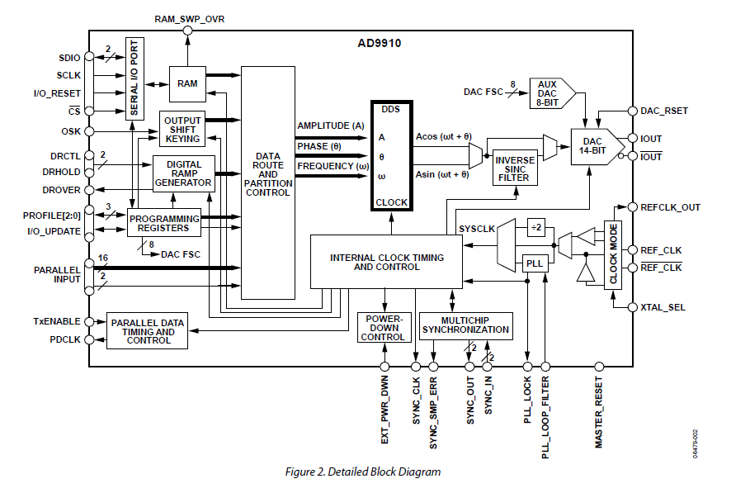
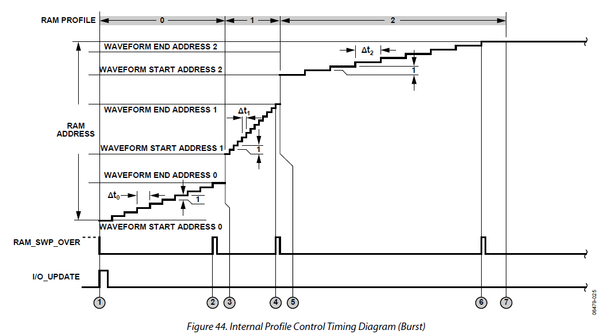
AD9910
4 mode available
Single ton mode (8 profile)
Ram mode (32 * 1024 RAM)
Parallel mode (real time parameter supply)
DRG mode

Slide 6
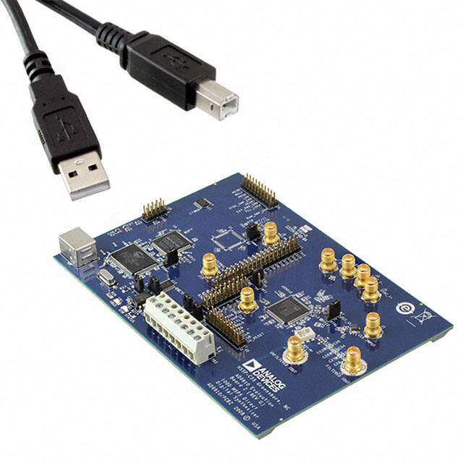
AD9910
4 mode available
Single ton mode (8 profile)
Ram mode (32 * 1024 RAM)
Parallel mode (real time parameter supply)
DRG mode
most similar mode

Slide 7
Evaluation Board Test

Slide 8
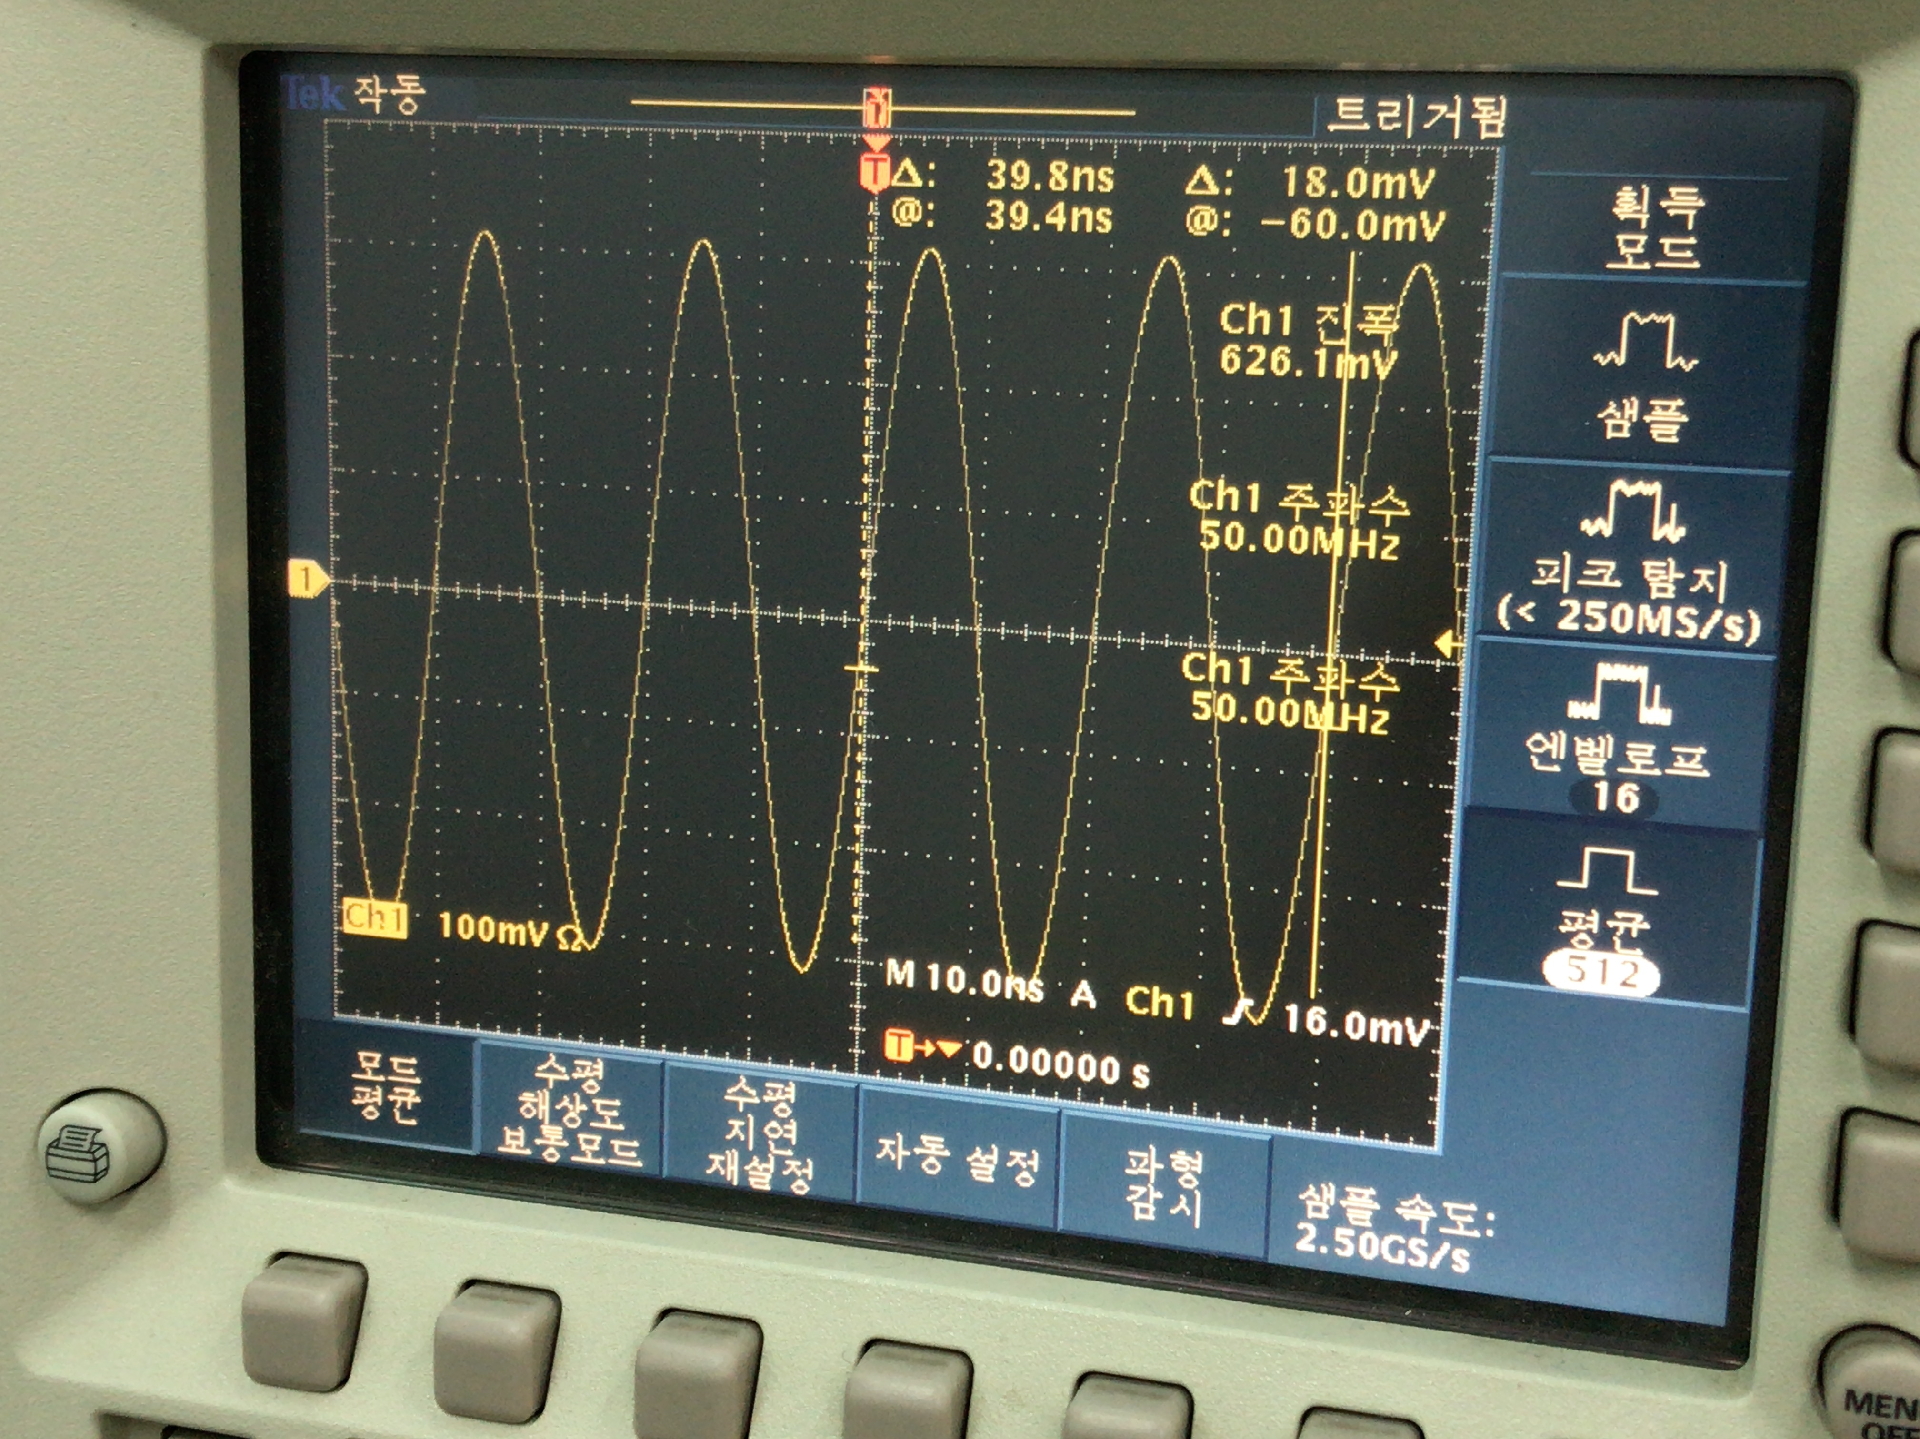
AD9910 evaluation board test
Tested using modified AD9912 Verilog code
Python code for AD9910 is written

Slide 9
Modification of AD9912 code
DDS_clock
rsclk
rcsbar_1
changed to DDS IOUPDATE
rcsbar_2
ja_7
DDS1_powerdown
ja_6
rsdio_1
ck_io_6
ldac_bar
ja_5
ck_io_39
DAC_cs_bar[0]
[1:0] DAC_cs_bar
ja_4
DDS_reset
ck_io_38
DAC_sclk[0]
[1:0] DAC_sclk
ja_3
ck_io_37
DAC_sdi[0]
[1:0] DAC_sdi
ja_2
DDS2_powerdown
ck_io_36
DAC_cs_bar[1]
ja_1
rsdio_2
ck_io_35
DAC_sclk[1]
ja_0
ck_io_34
DAC_sdi[1]

Slide 10
while(1):
print('[1] set_frequency(self, freq, ch1, ch2, unit = \'MHz\')’)
…
order = input('select funct you want to implement')
if( order == '1' ):
freq_in_MHz = float(input('freq_in_MHz : '))
ch1 = int(input('ch1 : '))
ch2 = int(input('ch2 : '))
dds.set_frequency(freq_in_MHz, ch1, ch2)
…
elif( order == '4' ):
freq = float(input('freq : '))
phase = float(input('phase : '))
amplitude = float(input('amplitude : '))
ch1 = int(input('ch1 : '))
ch2 = int(input('ch2 : '))
profile = int(input('profile : '))
dds.set_profile(freq, phase, amplitude, ch1, ch2, profile
= 0, unit_freq = 'MHz', unit_phase = 'FRAC')
elif( order == '5'):
dds.io_update()
elif( order == '6'):
ch1 = int(input('ch1 : '))
ch2 = int(input('ch2 : '))
dds.set_CFR1(ch1, ch2)

Slide 11
Verilog code & python code for AD9910

Slide 12
To employ more AD9910 modes
4 mode available
Single ton mode (8 profile)
Ram mode (32 * 1024 RAM)
Parallel mode (real time parameter supply)
DRG mode

Slide 13
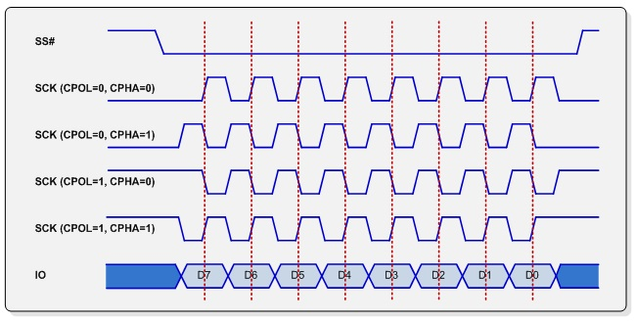
New AD9910 Verilog code
Use Same main FSM
Read & Write is available
4 SPI mode, length of signal can be selected
auto mode available (using FIFO)
Error register added (busy, overrided, overflow, timestamp)
Parallel output available
SPI configuration
lsb_first
slave_en
end_spi
[4:0]dummy
[7:0]cs
[4:0]length
cspol
cpol
cpha
[7:0]clk_div
auto mode data
[127:112] dummy
[111:95] dest
[95:32] timestamp
[31:0] data
[15:12] dest
[11:0] dest
override data
functionality
slack
[63:48] dummy
[47:95] dest
[31:0] data

Slide 14
write32 function
delayed_cycle = 0
config_int_list1 = self.set_config(cs = ((ch2 << 1) | (ch1 << 0)),
length = 8)
addr_int_list = self.make_write_list(register_addr << 24)
config_int_list2 = self.set_config( cs = ((ch2 << 1)|(ch1 << 0)),
length = 32, end_spi = 1 )
data_int_list = self.make_write_list(register_data)
if( self.auto_en ):
fifo_config_int_list1 = self.convert_to_16_int_list(config_int_list1)
self.delay_cycle(1)
fifo_addr_int_list = self.convert_to_16_int_list(addr_int_list)
self.delay_cycle(self.write_32_duration)
fifo_config_int_list2 = self.convert_to_16_int_list(config_int_list2)
self.delay_cycle(1)
fifo_data_int_list = self.convert_to_16_int_list(data_int_list)
self.delay_cycle(self.write_32_duration)
self.fpga.send_mod_BTF_int_list(fifo_config_int_list1)
self.fpga.send_command('WRITE FIFO')
self.fpga.send_mod_BTF_int_list(fifo_addr_int_list)
self.fpga.send_command('WRITE FIFO')
self.fpga.send_mod_BTF_int_list(fifo_config_int_list2)
self.fpga.send_command('WRITE FIFO')
self.fpga.send_mod_BTF_int_list(fifo_data_int_list)
self.fpga.send_command('WRITE FIFO')
delayed_cycle += 2 * ( self.write_32_duration + 1 )
else:
self.fpga.send_mod_BTF_int_list(config_int_list1)
self.fpga.send_command('WRITE DDS REG')
self.fpga.send_mod_BTF_int_list(addr_int_list)
self.fpga.send_command('WRITE DDS REG')
self.fpga.send_mod_BTF_int_list(config_int_list2)
self.fpga.send_command('WRITE DDS REG')
self.fpga.send_mod_BTF_int_list(data_int_list)
self.fpga.send_command('WRITE DDS REG’)
self.delay_cycle(-delayed_cycle)

Slide 15
Block diagram
[15:12] dest
[11:0] dest
IO update
gpo_core
rto_core
override
main FSM
destination check
Parallel
fifo
Profile
automode
SPI module
gpi_core
rti_core
destination check
fifo

Slide 16
Block diagram
single_spi_output
spi_fsm(AD9910_1)
gpo_core(spi_config)
rto_core(rto_core)
[63:0]gpo_out
[127:0]error_data
busy
SPI_FSM
overrided
counter_matched
timestamp_error
sck
sdi
selected
overflow_error
busy_error
[127:0]rto_out
io[1:0]
sdo
counter_matched
full
cs[1:0]
slave_en
[127:0]gpo_in
empty
cspol
[63:0]override_value_input
auto_start
cpol
override_en_input
[127:0]fifo_din
cpha
selected_input
reset
spi_off
write
new_in
[63:0]counter
cs_next
flush
sck_next
clk
[127:0]timestamp_error_data
simple_output(io_update)
[127:0]overflow_error_data
simple_output(profile)
gpi_core
rti_core()
[31:0]din
[127:0]rti_in
[127:0]overflow_error_data
data_ready
write
write
read
[127:0]gpi_out
[63:0]counter
[127:0]rti_out
[63:0]counter
simple_output(parallel)
flush
overflow_error
underflow_error
full
empty

Slide 17
Pin layout
jb_1
F[1]
jb_0
F[0]
IOBUF
ja_7
DDS1_ioupdate
jc_7
ja_6
io[0]
jc_6
ja_5
cs1
jc_5
ja_4
DDS1_TxEnable
jc_4
ja_3
sck
IOBUF
jc_3
ja_2
DDS2_ioupdate
jc_2
[17:0] parallel_out
ja_1
io[1]
jc_1
ja_0
cs2
jc_0
jb_7
[2:0]DDS1_profile
jd_7
jb_6
jd_6
jb_5
jd_5
jb_4
[2:0]DDS2_profile
jd_4
jb_3
jd_3
jb_2
jd_2
jd_1
jd_0

Slide 18
Example Code (auto mode)
def exp1():
dds = AD9910(ArtyS7('COM12’), min_freq = 10 * MHz, max_freq = 400 * MHz, sys_clk = 1000 * MHz,
dest_val = 1, auto_en = False)
dds.reset_driver()
dds.auto_mode()
dds.set_profile_register(ch1 = 1, ch2 = 1, freq = 50 * MHz, phase = 0 * RAD,
amplitude = 1.0, profile = 0)
dds.delay_cycle(10000)
dds.set_profile_register(ch1 = 1, ch2 = 1, freq = 100 * MHz, phase = 0 * RAD,
amplitude = 1.0, profile = 1)
dds.delay_cycle(10000)
dds.set_profile_pin(profile1 = 1, profile2 = 0)
dds.auto_start()
UartRx
reset_driver
set_profile_register
set_profile_register
set_profile_pin
auto_start
counter
0
10000
20000
CSB
profile
0
1

Slide 19
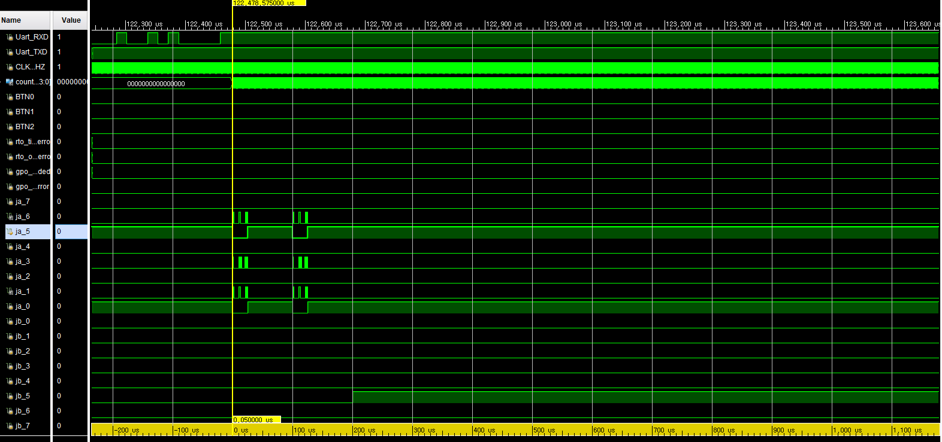
exp1 waveform
io[0]
csb[0]
sck
io[1]
csb[1]
profile1[2]
profile1[1]
profile1[0]

Slide 20
Example Code (Error example)
def exp2():
dds = AD9910(ArtyS7('COM12'))
dds.reset_driver()
dds.auto_mode()
dds.delay_cycle(500)
dds.set_profile_register(ch1 = 1, ch2 = 1, freq = 50 * MHz, phase = 0 * RAD,
amplitude = 1.0, profile = 0)
dds.set_parallel_amplitude(amplitude = 1.0, parallel_en = 1)
dds.auto_start()
dds.read_exception_log()
UartTx
error data
UartRx
reset_driver
set_profile_register
set_parallel_amplitude
auto_start
read_exception_log
counter
0
500
CSB
timestamp error

Slide 21
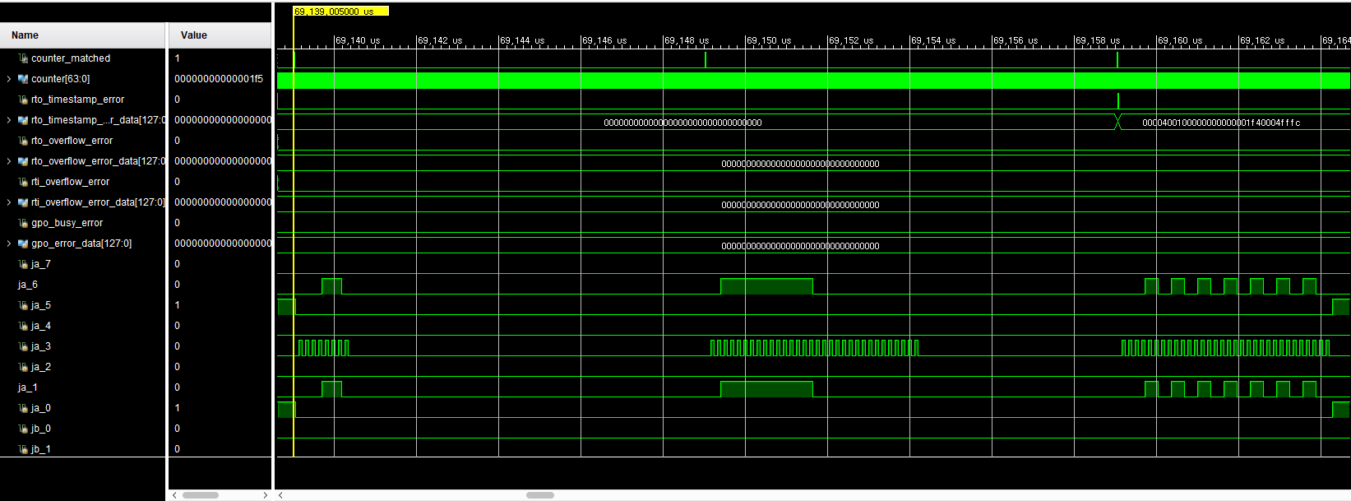
exp2 waveform

Slide 22
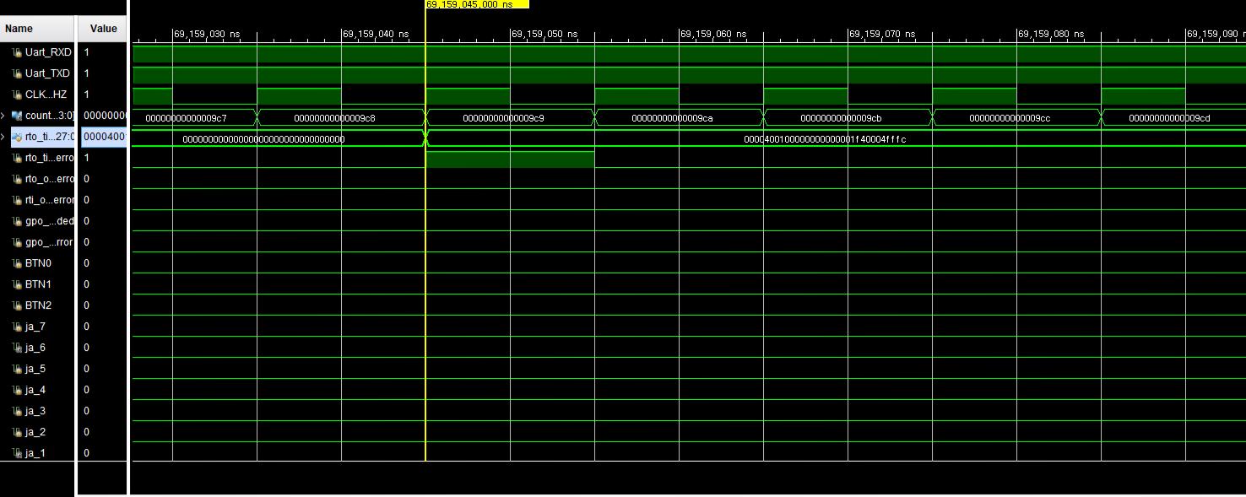
exp2 waveform

Slide 23
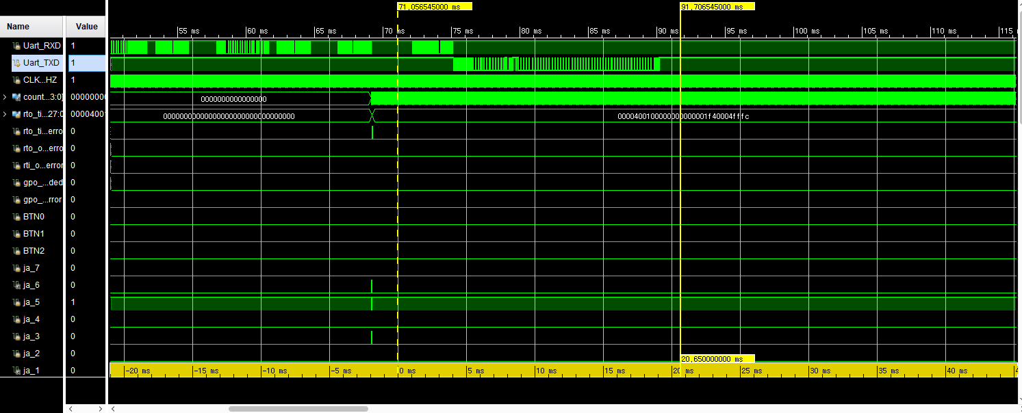
exp2 waveform

Slide 24
Received error data
#3 0x041
0b00010000
0x0000400100000000000001f40004fffc
000…000
\r \n
length
error
error data

Slide 25
Example Code (override)
def exp3():
dds = AD9910(ArtyS7('COM12'))
dds.reset_driver()
dds.override_enable()
dds.set_profile_register(ch1 = 1, ch2 = 1, freq = 50 * MHz, phase = 0 * RAD,
amplitude = 1.0, profile = 0)
dds.set_profile_register(ch1 = 1, ch2 = 1, freq = 100 * MHz, phase = 0 * RAD,
amplitude = 1.0, profile = 1)
dds.set_profile_pin(profile1 = 1, profile2 = 0)
dds.set_parallel_amplitude(amplitude = 1.0, parallel_en = 1)
dds.initialize(1,1)
dds.read32(1,0,0x00)
dds.read32(0,1,0x01)
dds.read32(1,0,0x02)
dds.read_rti_fifo()
dds.read_rti_fifo()
dds.read_rti_fifo()
dds.read_rti_fifo()
dds.read_rti_fifo()

Slide 26
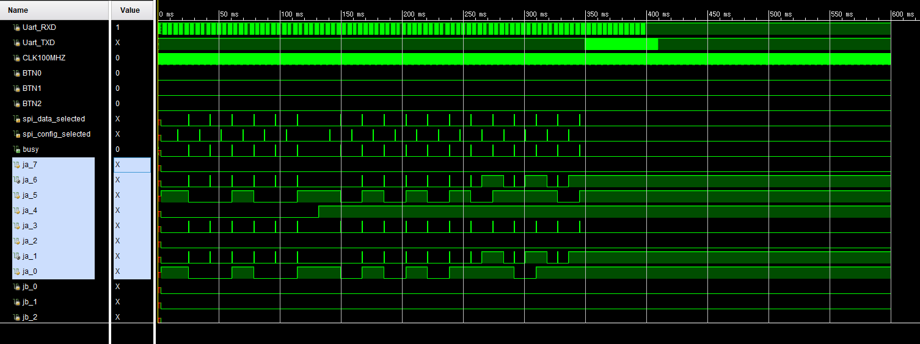
exp3 waveform

Slide 27
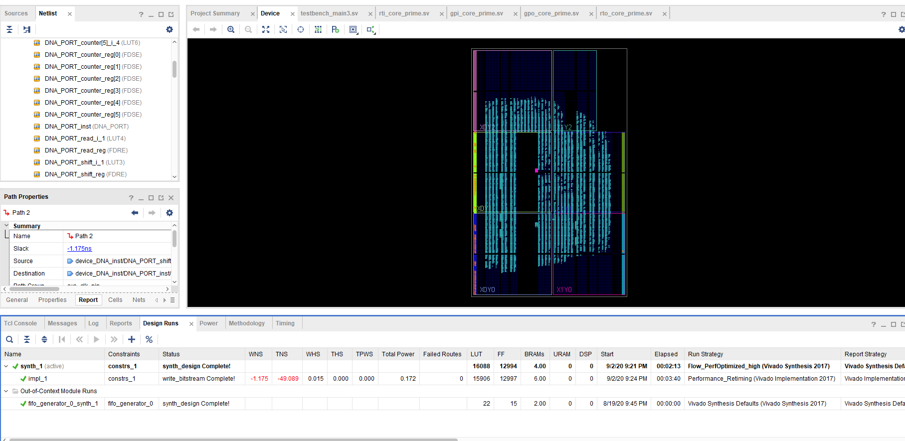

Slide 28
Things can be improved

Slide 29
[15:12] dest
[11:0] dest
IO update
gpo_core
rto_core
override
main FSM
destination check
Parallel
fifo
Profile
automode
SPI module
gpi_core
rti_core
destination check
fifo

Slide 30
IO update
gpo_core(AD9910_1)
FSM
Or
Processor
Parallel
destination check
rto_core
distributor
Profile
fifo
SPI module
Port1
gpo_core(Others1)
Port2
destination check
Port3
rto_core
Port4
fifo
Port1
gpo_core(Others2)
Port2
destination check
Port3
Port4
rto_core
Port1
gpo_core(Others3)
Port2
destination check
fifo
Port3
Port4
1. wasting resource which is not used many time
and parallel output is not always required
2. need to update fifo in real time
rti_core
fifo

Slide 31
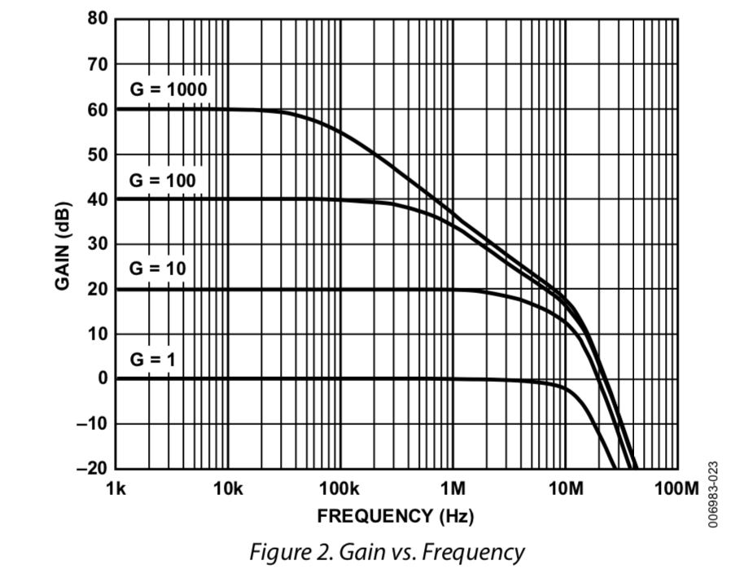
ADC Sampler
Sampler Spec
- 8-channel
- 16-bit 1.5MSPS/ch ADC LTC2320-16 ( $48.66 )
- 8 PGIA AD8253 ( $11.36 )
G = 1, 10, 100, 1000
- Basic mode : Sequential input, 700kHz
use single EEM
- Fast mode : Simultaneous input, 1MHz
use dual EEM
- Sample – Urukul Servo mode possible
- USD $1,600
2 x EEM port
ADC chip
8 x PGIA chip
IDC
8 x BNC

Slide 32
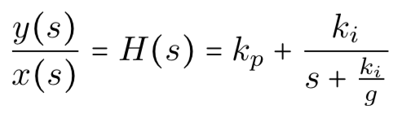
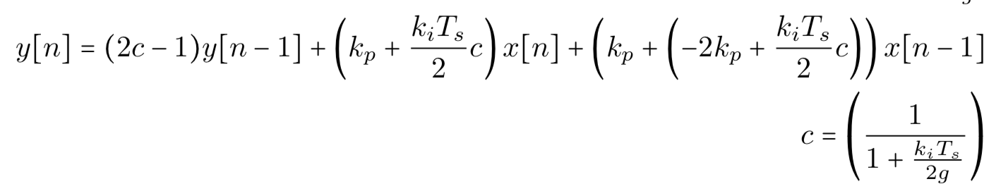
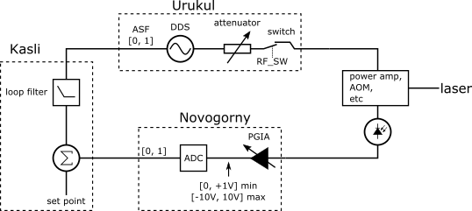
Sampler – Urukul Servo mode (SUSERVO)
- DSP is implemented as a module
- 2 Urukul board per 1 Sampler board

